Slide 1
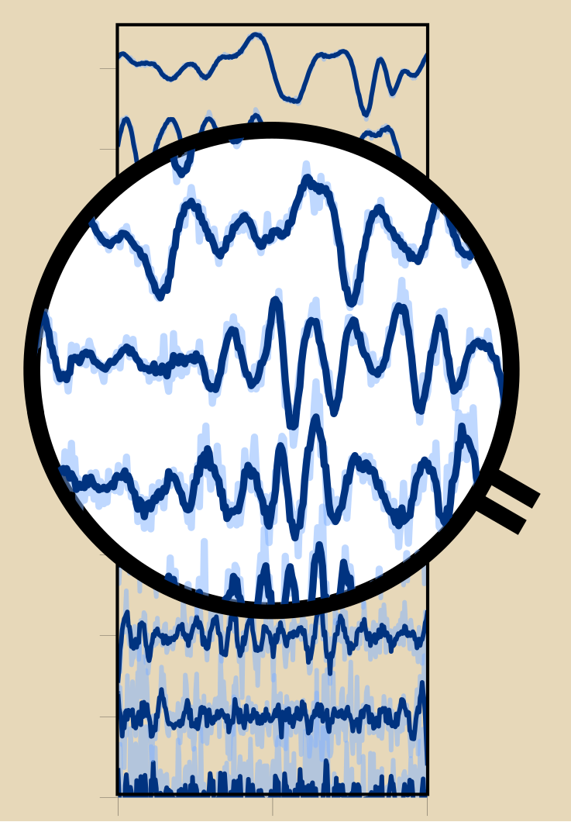
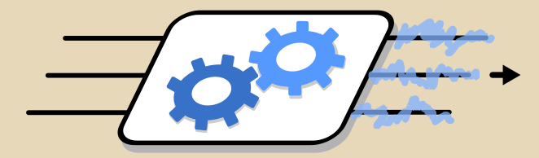
Physical Computing at the Quantum limit: Harnessing fundamental noise in learning with quantum systems
Saeed A. Khan
Department of Electrical Engineering, Princeton University

Slide 2



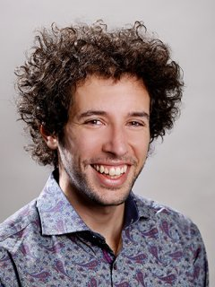

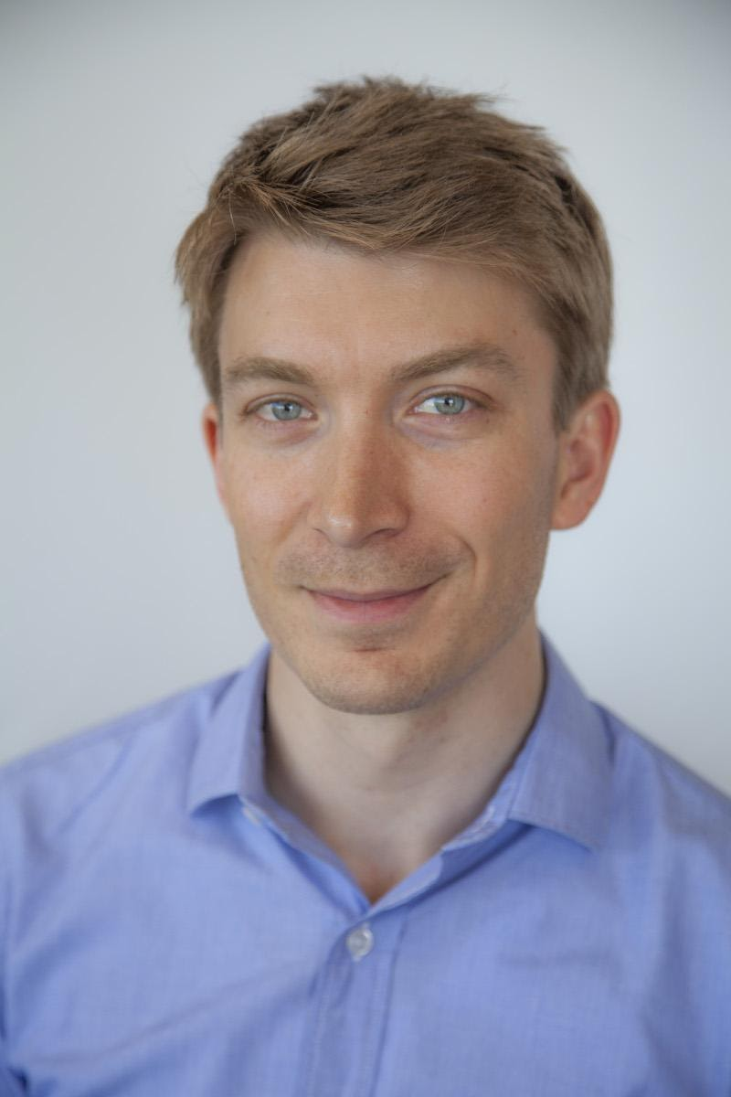
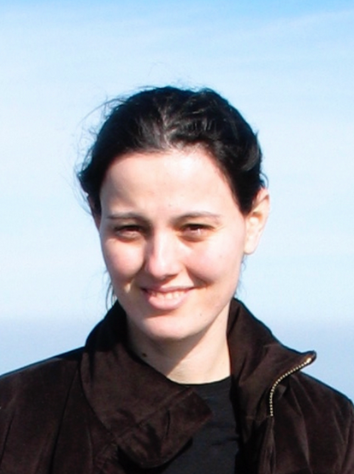
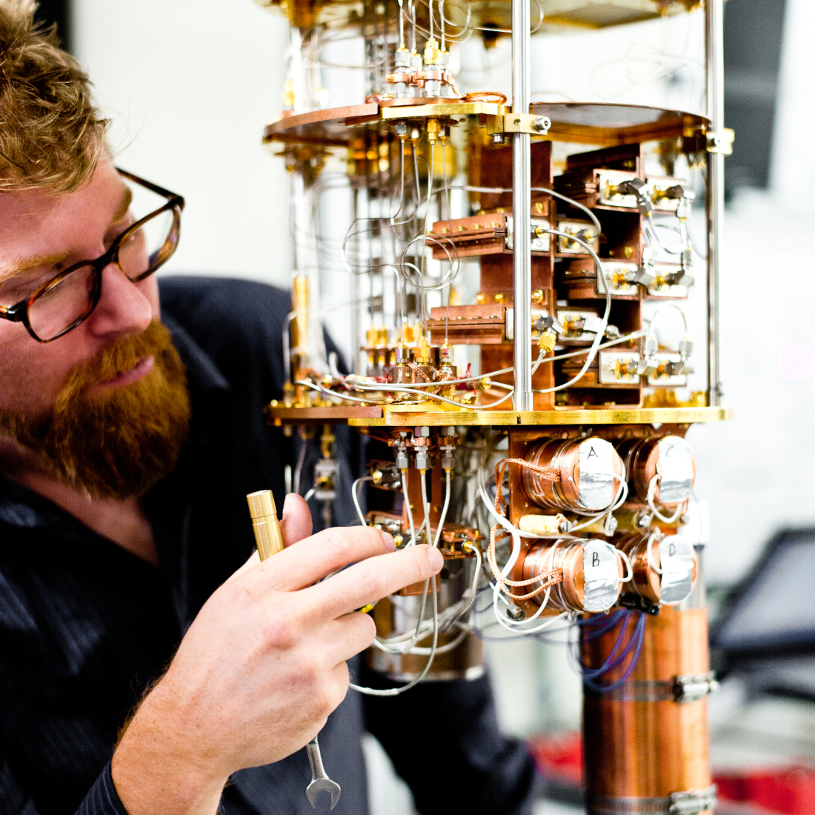
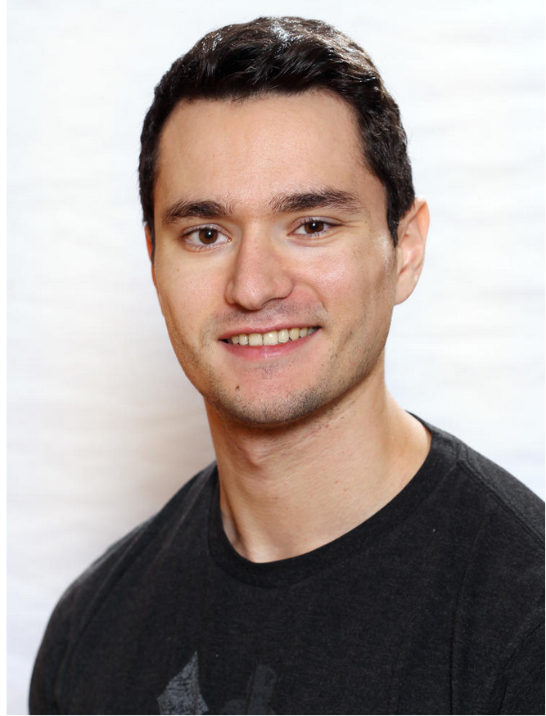



Team and Acknowledgements
PI: Hakan E. Türeci
(Princeton ELE)
Fangjun Hu*
(Princeton ELE)
Leon Bello
(Princeton ELE)
Gerasimos Angelatos*
(BBN)
Guilhem Ribeill
(BBN)
Graham Rowlands
(BBN)
Funding agencies:
Esin Türeci
(Princeton CS)
Nick Bronn
(IBM)
Marti Vives
(Princeton ELE, now Q-Ctrl)

Slide 3


Quantum Limit of PNNs
Input
PNN^{[1]}
Output
[1] Wright, Onodera et al., Nature (2022)
Notes:
Here showing a physical neural network. Generally classical and quantum may be viewed as separate. But operation at low temperatures and few-photon excitation will naturally require the quantum limit of a PNN.

Slide 4
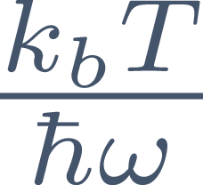
Quantum Limit of PNNs
Lowest-energy operation at any frequency: naturally approach quantum limit!
Input
PNN^{[1]}
Output
[1] Wright, Onodera et al., Nature (2022)
Notes:
Noise in computing with physical systems. Quantum noise. Task-independent metric. Computing beyond lifetimes

Slide 5
Quantum Limit of PNNs
Lowest-energy operation at any frequency: naturally approach quantum limit!
Input
PNN^{[1]}
Output
Measurement noise is an important consideration in computation, but unavoidable in quantum systems.
Large Hilbert Space, but also limitations due to Quantum Measurement Theory: sampling noise, backaction.
Truly quantum effects ultimately present in quantum noise.
Our interest: Characterize, Harness, and Engineer quantum fluctuations for learning
[1] Wright, Onodera et al., Nature (2022), [2] Dambre et al., Sci. Rep. (2012), [3] Gherardini et al., PRE (2021)
Notes:
Noise in computing with physical systems. Quantum noise. Task-independent metric. Computing beyond lifetimes

Slide 6
Quantum Limit of PNNs
Lowest-energy operation at any frequency: naturally approach quantum limit!
Input
PNN^{[1]}
Output
Measurement noise is an important consideration in computation, but unavoidable in quantum systems.
Task-independent metric^{[2]} for quantifying computational capacity in presence of noise
Harness noise correlations to provide robust learning with noisy systems: Eigentask learning
Algorithm overcoming measurement-induced scrambling ^{[3]} in monitored quantum systems, enabling learning beyond coherence lifetimes
Large Hilbert Space, but also limitations due to Quantum Measurement Theory: sampling noise, backaction.
Truly quantum effects ultimately present in quantum noise.
Our interest: Characterize, Harness, and Engineer quantum fluctuations for learning
[1] Wright, Onodera et al., Nature (2022), [2] Dambre et al., Sci. Rep. (2012), [3] Gherardini et al., PRE (2021)
Notes:
Noise in computing with physical systems. Quantum noise. Task-independent metric. Computing beyond lifetimes

Slide 7
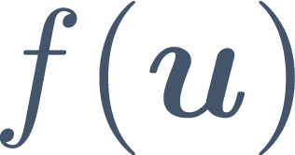

Quantum Limit of PNNs
Function-based approach to learning (in contrast to task-based)
Target
Estimate
Input
PNN^{[1]}
Output
[1] Wright, Onodera et al., Nature (2022), [2] Dambre et al., Sci. Rep. (2012)

Slide 8

Quantum Limit of PNNs
Function-based approach to learning (in contrast to task-based)
Target
Estimate
Input
PNN^{[1]}
Output
QRC
[1] Wright, Onodera et al., Nature (2022), [2] Dambre et al., Sci. Rep. (2012)

Slide 9
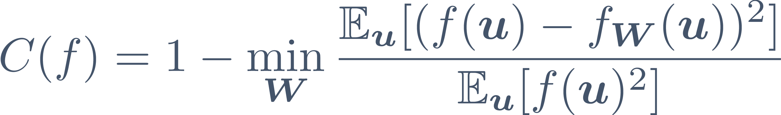
Quantum Limit of PNNs
Function-based approach to learning (in contrast to task-based)
Target
Estimate
Input
PNN^{[1]}
Output
QRC
Capacity: depends on mean squared error in approximating a target function using stochastic outputs
[1] Wright, Onodera et al., Nature (2022)

Slide 10
Resolvable Expressive Capacity and Eigentasks
[4] Hu*, Angelatos*, Khan* et al., PRX 13, 041020 (2023)

Slide 11
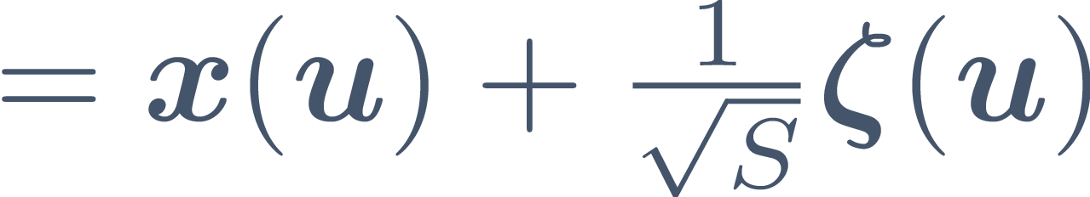


Resolvable Expressive Capacity and Eigentasks
-dim.
Mean
Noise
: Samples
[4] Hu*, Angelatos*, Khan* et al., PRX 13, 041020 (2023)

Slide 12
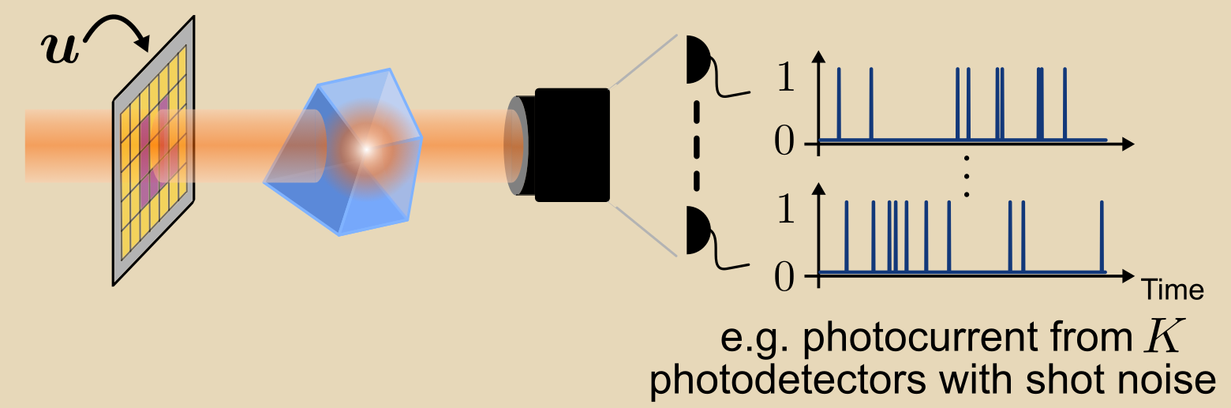
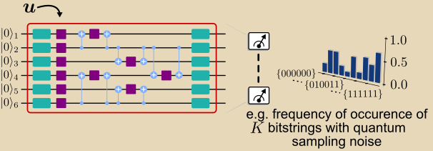
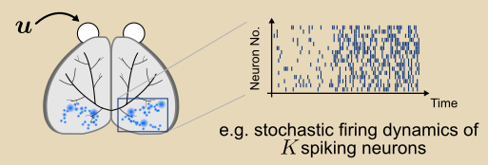
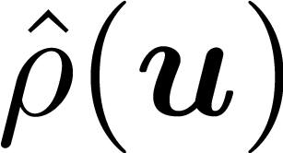

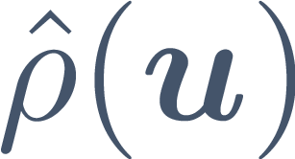
Resolvable Expressive Capacity and Eigentasks
Optical systems
Quantum systems
Biological systems
Quantum systems: depend on , which can be hard to generate classically!
[4] Hu*, Angelatos*, Khan* et al., PRX 13, 041020 (2023)

Slide 13


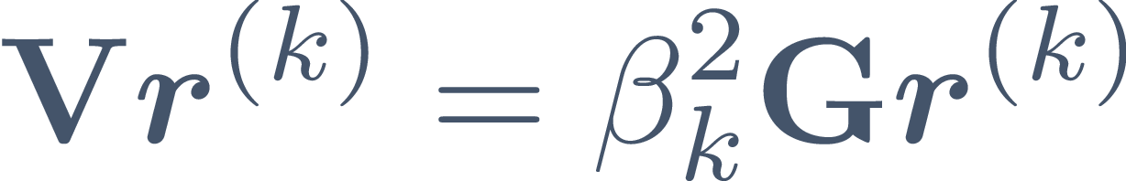
Resolvable Expressive Capacity and Eigentasks
Optical systems
Quantum systems
Biological systems
Quantum systems: depend on , which can be hard to generate classically!
Gram matrix
Covariance matrix
Linear eigenvalue problem:
[4] Hu*, Angelatos*, Khan* et al., PRX 13, 041020 (2023)

Slide 14
Resolvable Expressive Capacity (REC)
Eigentasks
[4] Hu*, Angelatos*, Khan* et al., PRX 13, 041020 (2023)

Slide 15
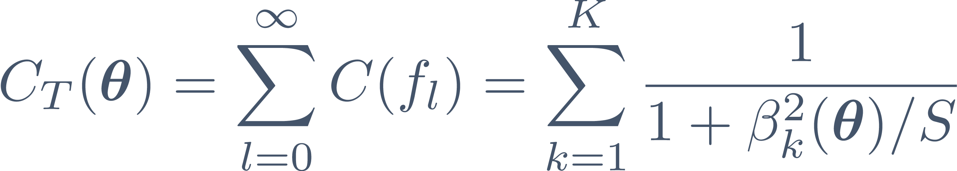




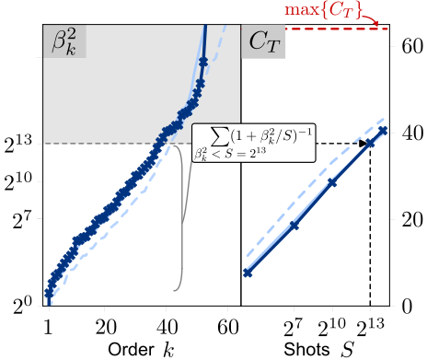
Resolvable Expressive Capacity (REC)
Eigentasks
for readout features, readout qubits
Upper bound , only reached at infinite
Practically, limited by
[4] Hu*, Angelatos*, Khan* et al., PRX 13, 041020 (2023)

Slide 16
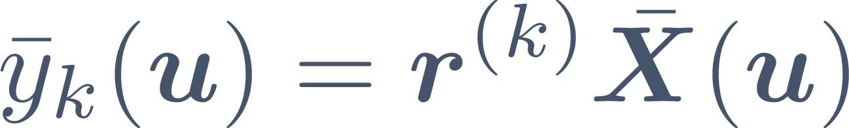

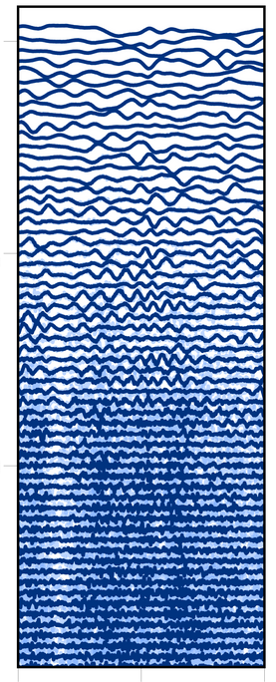
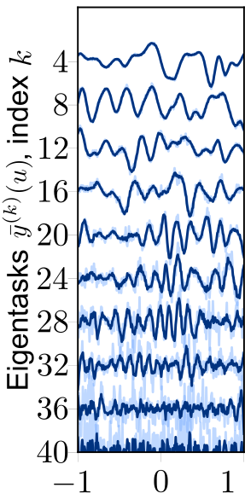
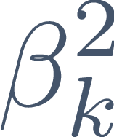
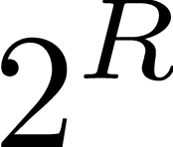



Resolvable Expressive Capacity (REC)
Eigentasks
Quantify resolvable function space accounting for the structure of quantum noise,
for readout features, readout qubits
Ordered by increasing
noise-to-signal eigenvalues
Upper bound , only reached at infinite
Practically, limited by
Higher-order eigentasks contribute less to REC at any finite (i.e. they are more difficult to resolve)
Input
[4] Hu*, Angelatos*, Khan* et al., PRX 13, 041020 (2023)

Slide 17
Eigentask Learning
Eigentasks provide a basis of outputs ordered by their noise content!
[4] Hu*, Angelatos*, Khan* et al., PRX 13, 041020 (2023)

Slide 18
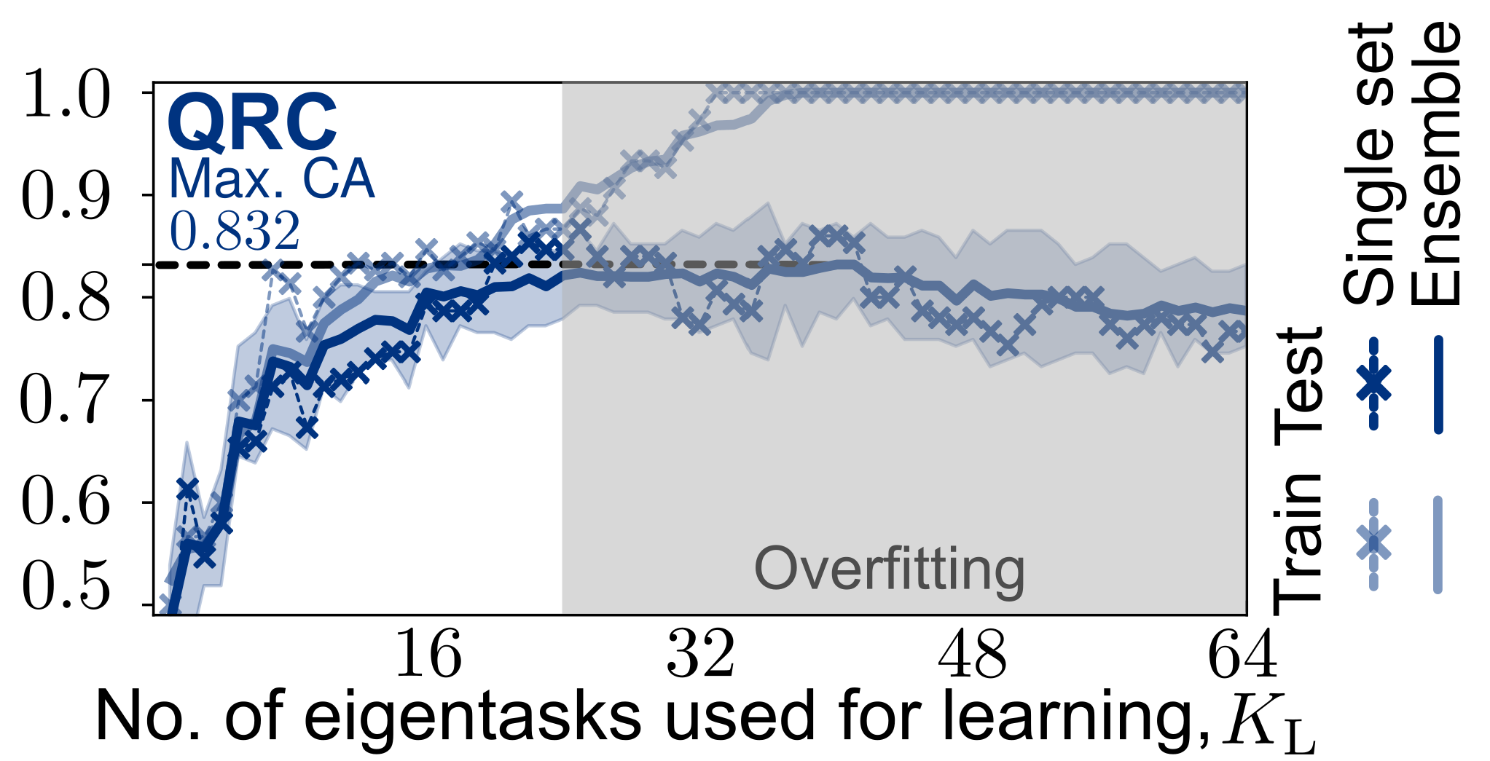
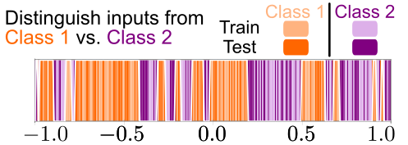
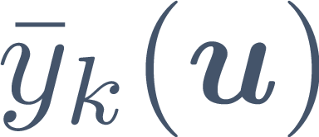
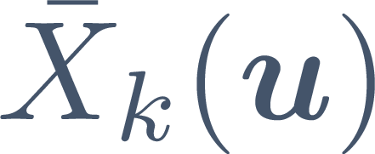
Eigentask Learning
Eigentasks provide a basis of outputs ordered by their noise content!
Use
for training
instead of
Input
Reduce overfitting and improve generalizability when learning under limited shots .
More advantageous with increasing readout dimension (i.e. quantum system size).
Poster: Gerry Angelatos
[4] Hu*, Angelatos*, Khan* et al., PRX 13, 041020 (2023)

Slide 19
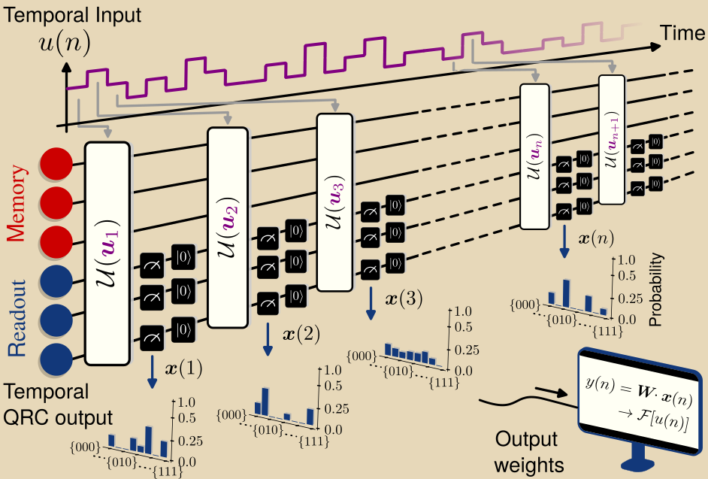
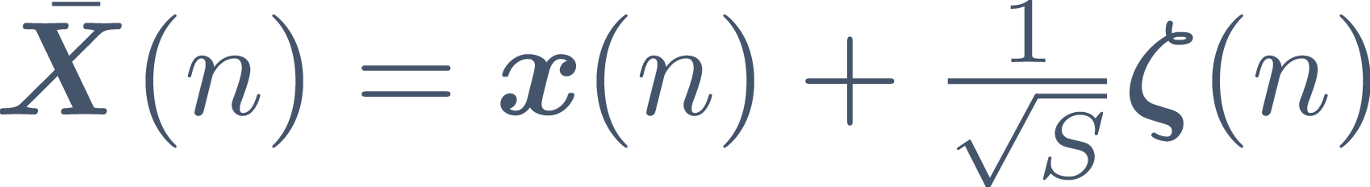
Online learning using quantum systems
Time-evolving inputs and targets
Now, repeated measurements necessary to extract time-evolving outputs,
Consideration beyond sampling noise: measurement backaction and thermalization!
Propose NISQRC algorithm: memory and readout subsystem divisions + partial reset operations
[5] Hu*, Khan* et al., arXiv: 2312.16165 (2023), [6] Senanian et al., arXiv: 2312.16166 (2023)
Notes:
In the second part of my talk, I will discuss extensions to time-evolving inputs and outputs, a kind of temporal processing that has gained recent interest, including this recent work by our friends in peter mcmahons group. In particular we consider a time-dependent input, indexed by n, that is input sequentially to a QRC, and outputs are repeatedly extracted via measurements, to construct a time-dependent target. In comparison to the previous situation I discussed, the use of repeated measurements requires us to address a second key aspect of quantum measurement theory, which is measurement backaction: the impact of a measurement on the quantum state and hence on all subsequent measurements, which we find can strongly limit the learning capability of the QRC. As a result of our work we proposed an algorithm called NISQRC

Slide 20
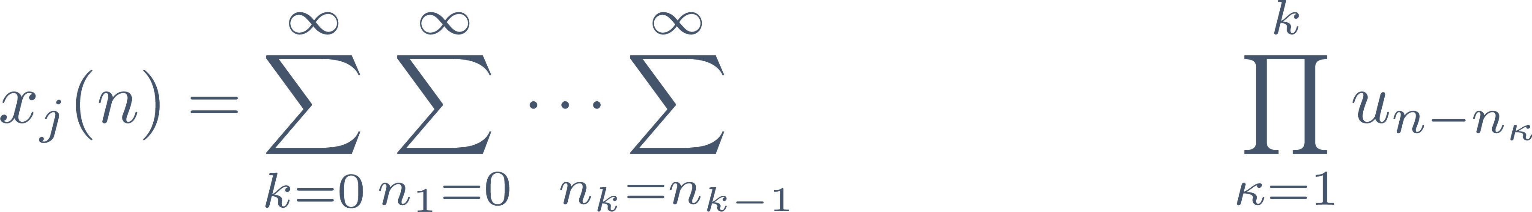
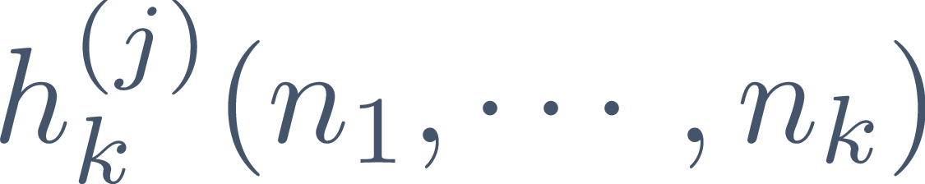
Online learning using quantum systems
Time-evolving inputs and targets
Now, repeated measurements necessary to extract time-evolving outputs,
Consideration beyond sampling noise: measurement backaction and thermalization!
Propose NISQRC algorithm: memory and readout subsystem divisions + partial reset operations
Extend classical Volterra series analysis^{[3]} to derive Quantum Volterra Theory,
[5] Hu*, Khan* et al., arXiv: 2312.16165 (2023), [6] Senanian et al., arXiv: 2312.16166 (2023), [7] Gonon et al., arXiv: 2212.14641 (2022)
Notes:
In the second part of my talk, I will discuss extensions to time-evolving inputs, which as you will see necessitates probing another key aspect of quantum measurement theory.

Slide 21




Online learning using quantum systems
Input encoding:
Quantum Volterra kernels
,
(also valid for more general measurements)
implements post-measurement reset to
[5] Hu*, Khan* et al., arXiv: 2312.16165 (2023)

Slide 22
Online learning using quantum systems
Input encoding:
Quantum Volterra kernels
,
(also valid for more general measurements)
implements post-measurement reset to
What determines magnitude and memory time of kernels?
[5] Hu*, Khan* et al., arXiv: 2312.16165 (2023)

Slide 23
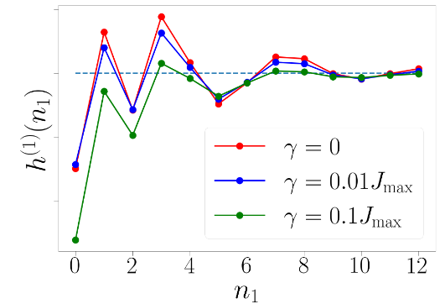
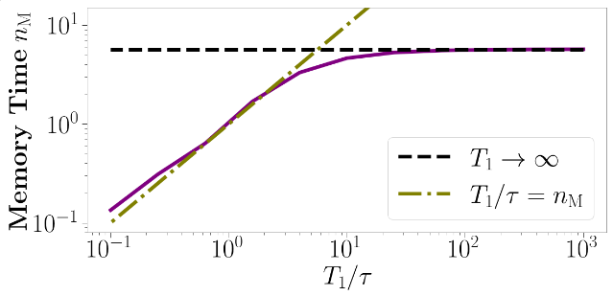

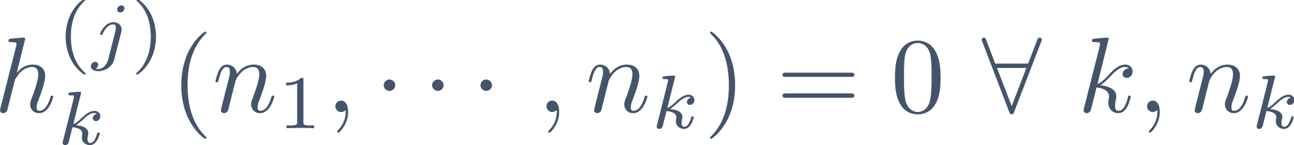


Online learning using quantum systems
Input encoding:
Quantum Volterra kernels
,
(also valid for more general measurements)
implements post-measurement reset to
What determines magnitude and memory time of kernels?
Absence of reset:
Amnesiac system due to measurement induced thermalization^{[3]}!
Persistent memory time not necessarily set by qubit lifetimes!
Moderate dissipation does not destroy kernels!
[5] Hu*, Khan* et al., arXiv: 2312.16165 (2023), [3] Gherardini et al., PRE (2021)

Slide 24

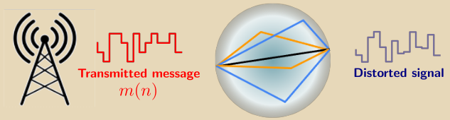
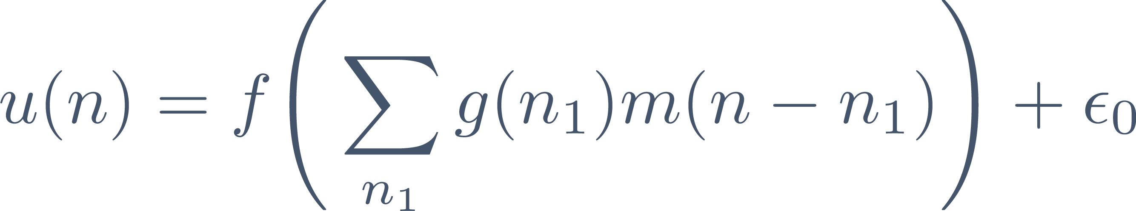
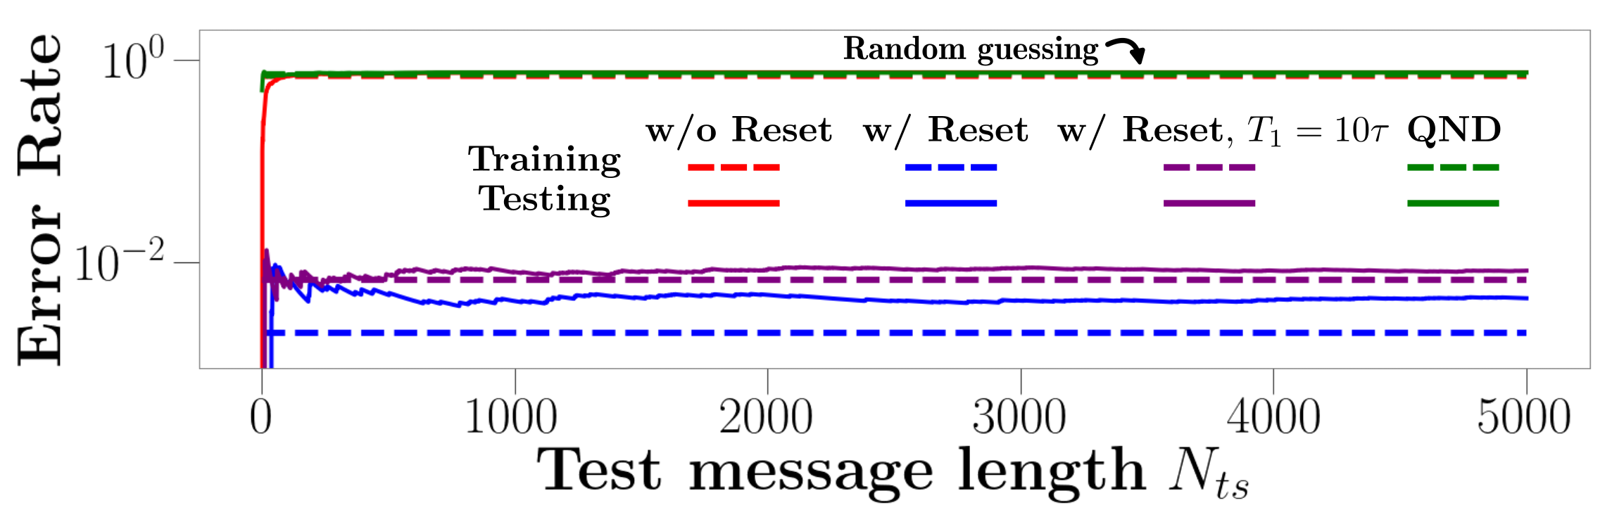
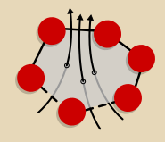


Online learning using quantum systems
Channel Equalization
Quantum Annealers
[5] Hu*, Khan* et al., arXiv: 2312.16165 (2023)

Slide 25
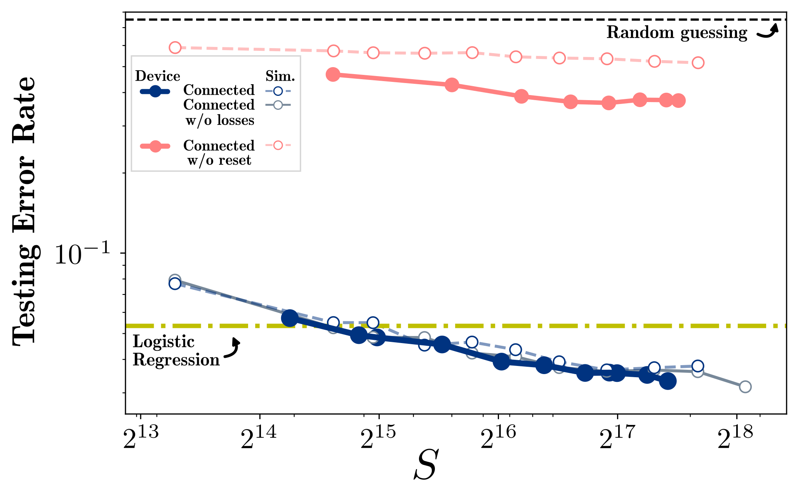
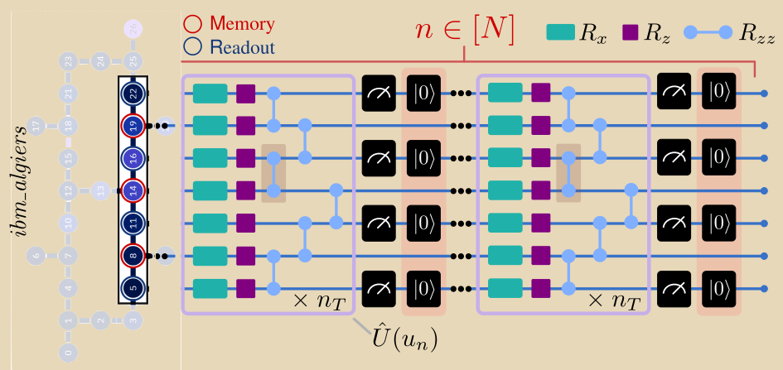


Online learning using quantum systems
Channel Equalization
IBMQ Experiments
Online learning algorithm - NISQRC – overcoming measurement-induced thermalization and can be run on input signal lengths unrestricted by qubit coherence times!
Poster: Fangjun Hu
[5] Hu*, Khan* et al., arXiv: 2312.16165 (2023)

Slide 26
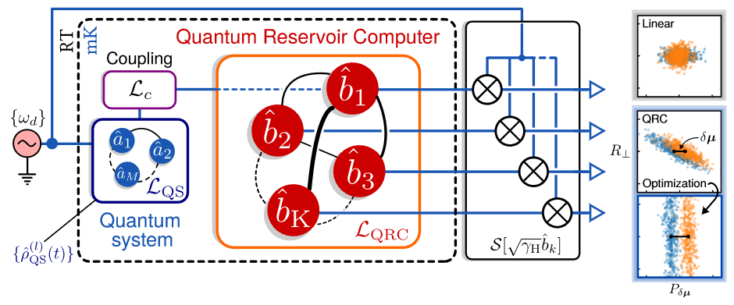



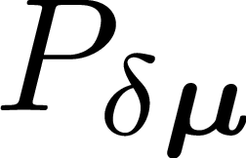
Engineering quantum fluctuations
Engineer quantum fluctuations using nonlinear bosonic QRCs:
Compute correlations in situ.
Engineer sub-vacuum fluctuations in non-local observables for classification, harnessing entanglement for learning.
Quantum sensing applications
Nonlinear
[8] Khan et al., arXiv: 2110.13849 (2021)

Slide 27
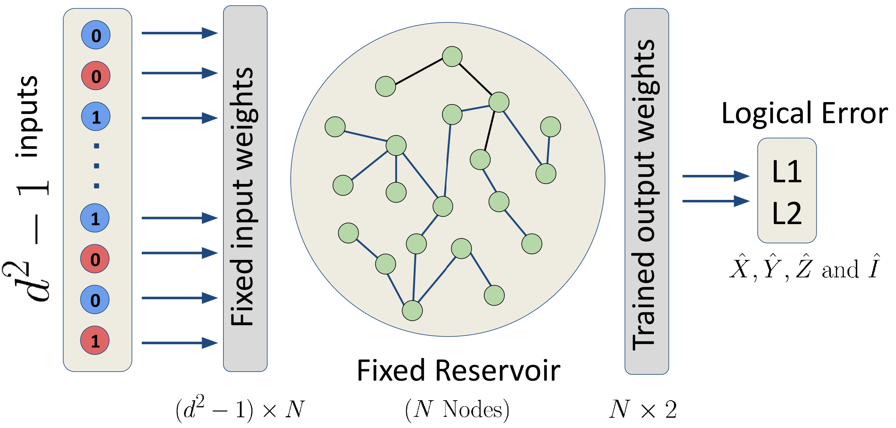
Engineering quantum fluctuations
Engineer quantum fluctuations using nonlinear bosonic QRCs:
Compute correlations in situ.
Engineer sub-vacuum fluctuations in non-local observables for classification, harnessing entanglement for learning.
Quantum sensing applications
Nonlinear
QRCs for quantum error syndrome detection
Poster: Leon Bello
[8] Khan et al., arXiv: 2110.13849 (2021)

Slide 28
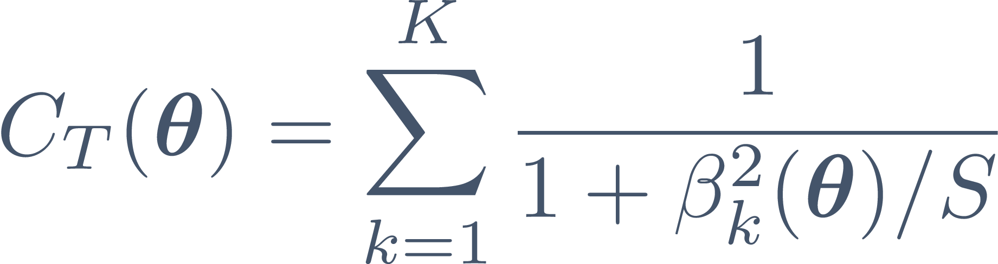
Conclusions and Outlook
Resolvable Expressive Capacity (REC)
For learning with general physical systems, including quantum systems
Eigentasks provide a noise-ordered basis for learning to improve generalizability
Online learning scheme – NISQRC - that can be run on input signal lengths unrestricted by qubit coherence times!
Applications to more complex tasks on larger quantum systems
Inform quantum system engineering/design for optimal learning
Thank you!
References:
Angelatos et al., PRX 11, 041062 (2021)
Khan et al., arXiv: 2110.13849 (2021)
Hu*, Angelatos*, Khan* et al., PRX 13, 041020 (2023)
Hu*, Khan* et al., arXiv: 2312.16165 (2023)
Khan et al., arXiv: 2310.18519 (2023)
Notes:
I hope I have convinced you that the study of quantum systems for physical computing arises naturally as we consider computation at lower and lower energies. We have developed tools to characterize and harness quantum properties of such systems, like the REC and eigentasks,

